Slide 1



Slide 2

Automated Fruit Freshness Recognition System
Supervised by
Dr. Yasir Ali Shah
Group Members
Usman Safdar(FA17-BCS-106)
Aimen Farooq(FA17-BCS-070)
Presented on
1,June,2021.
Department of Computer Science
COMSATS University Islamabad, Attock Campus

Slide 3
Outline
Introduction
Related Work
Problem Statement
Objectives
Requirement Specification
Methodology
Project Design
User Interface
Tools
Conclusion
Future Work
References
1/06/2021

Slide 4
Introduction
It is estimated that nearly a third of fruit costs go to decaying matters.
The anticipated system performs fruit freshness recognition and classify whether it is rotten or unrotten fruit.
This system uses image processing techniques for Recognition and Classification
This work is driven by the motive to make an effective and efficient system for checking the freshness of fruit with fast computational speed.
1/06/2021

Slide 5
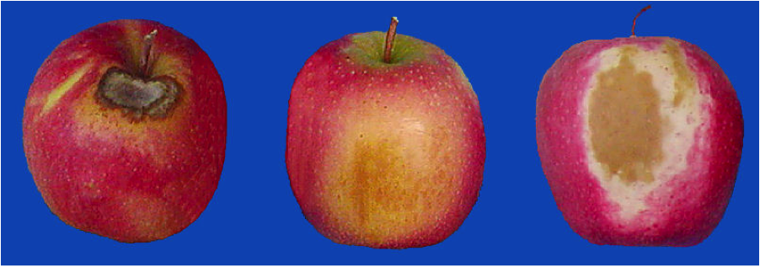
Cont.…
In the research, we are designing a complete structure based on neural network techniques to recognize the size, color, shape of the fruit.
Currently, we are using Deep Learning (DL) commonly used Machine Learning (ML) method in our recognition system.
Deep Learning Techniques are characterized by their high level of abstraction and the ability to automatically learn and recognize different modes of images once they have been trained.
1/06/2021

Slide 6
Related Work
Fruit Recognition System
Y.Song, proposed method for recognizing and counting fruits from images in cluttered greenhouses.
Fruit Detection using Deep Learning
Inkyu Sa, presents a novel approach for detecting fruits from images using deep neural networks. For this purpose, the author adapts a Faster Region-based convolutional network.
Deep Fruit Detection in Orchards
Bargoti S, proposed autonomous robots used for harvesting. It shows a network trained to recognize fruits in an orchard.
1/06/2021

Slide 7
Comparison Table
Title | Fruit Type and Classes | Detect Fruit types | Accuracy | Detect Freshness of Fruits
Fruit Recognition System | 1 Type 2 classes | Yes | 74% | No
Fruit Detection using Deep Learning | 1 Type | Yes | 79% | No
Deep Fruit Detection in Orchards | 3 Type of fruits | Yes | 83% | No
Automatic Fruit Freshness Recognition System | 3 Type of fruits with 2 classes of each | Yes | 94% | Yes
1/06/2021

Slide 8
Problem Statement
As most of the economic sector and people all over the world rely on fruits and their freshness is vital.
In this research, our main aim is to identify the problems related to the fruit freshness system.
This system will help wholesale dealers and the customers to check the fruit freshness and classify it as a rotten or an unrotten fruit.
1/06/2021

Slide 9
Objectives
Fruit Freshness recognition and classification.
Used in Real time applications.
Fast Computational time.
Flexible to handle large data.
Cost effective.
1/06/2021

Slide 10
Dataset
Fruits fresh and rotten for classification(Apples, Oranges, Bananas) Dataset.
Author: Sriram Reddy Kalluri.
Reference: Kalluri, S. R. (2018, August 24). Fruits fresh and rotten for classification. Retrieved October 7, 2020, from https://www.kaggle.com/sriramr/fruits-fresh-and-rotten-for-classification
Images | Fruits | Classes
9,000+ | 3 | Rotten Apples Unrotten Apples Rotten Bananas Unrotten Bananas Rotten Oranges Unrotten Oranges
1/06/2021
FYP Presentation

Slide 11
Requirements Specifications (Functional Requirements)
Upload image
Preprocessing
Classification
Output
1/06/2021

Slide 12
Requirements Specifications (Non-Functional Requirements)
Efficiency
Performance
Flexibility
Usability
Availability
Reliability
1/06/2021

Slide 13
Methodology
We would be using the Iterative Model because Requirements of Software are first broken down into several chunks that can be incrementally constructed and delivered.
At any time, the plan is made just for the next increment and not for any kind of long-term plan.
Therefore, it is easier to modify the version as per the needs.
1/06/2021

Slide 14
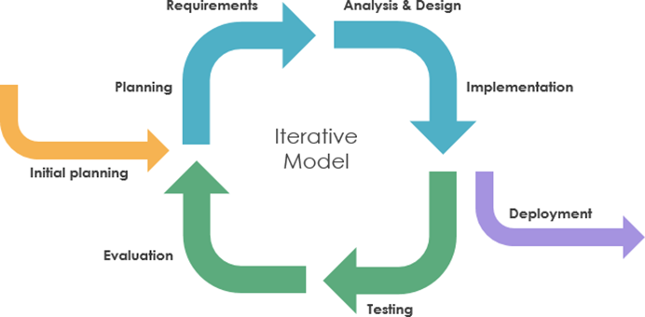
Methodology
1/06/2021

Slide 15
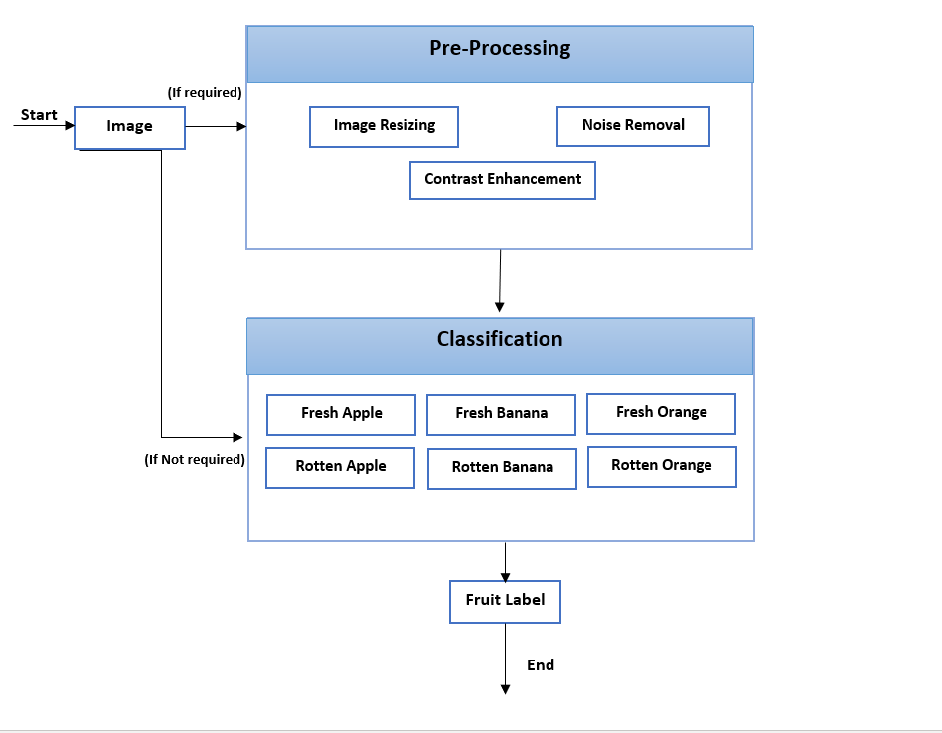
System Architecture
1/06/2021

Slide 16
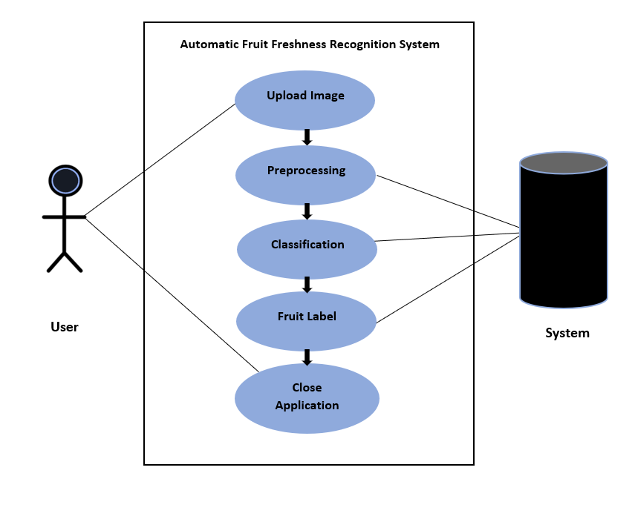
Project Design (Use Case Diagram)
1/06/2021

Slide 17
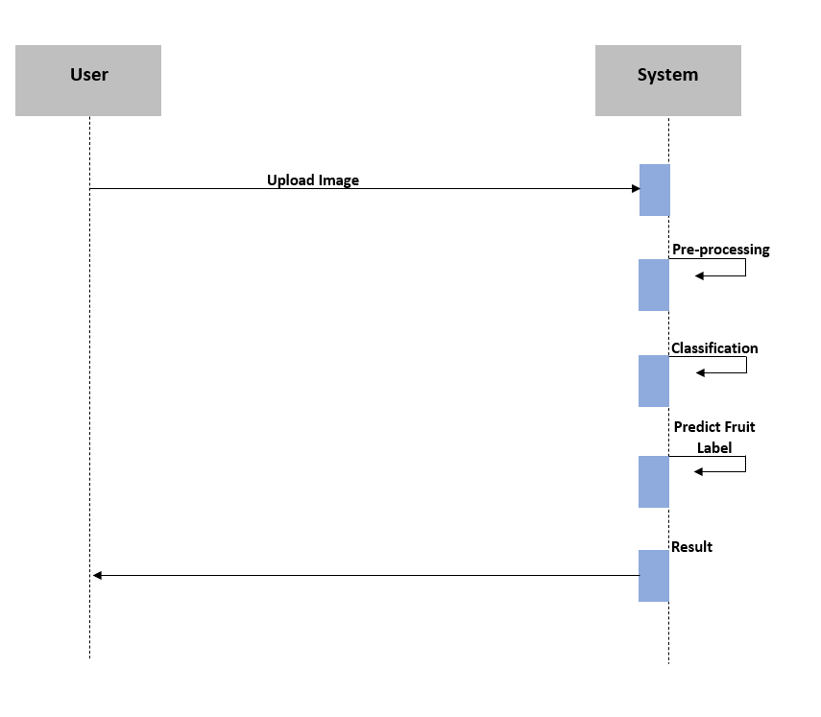
Project Design (Sequence Diagram)
1/06/2021

Slide 18
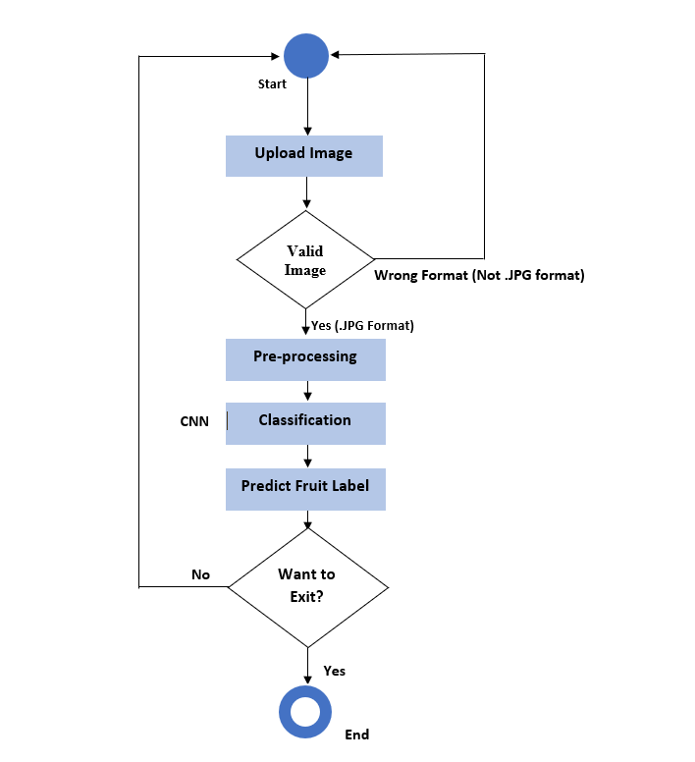
Project Design (Activity Diagram)
1/06/2021

Slide 19
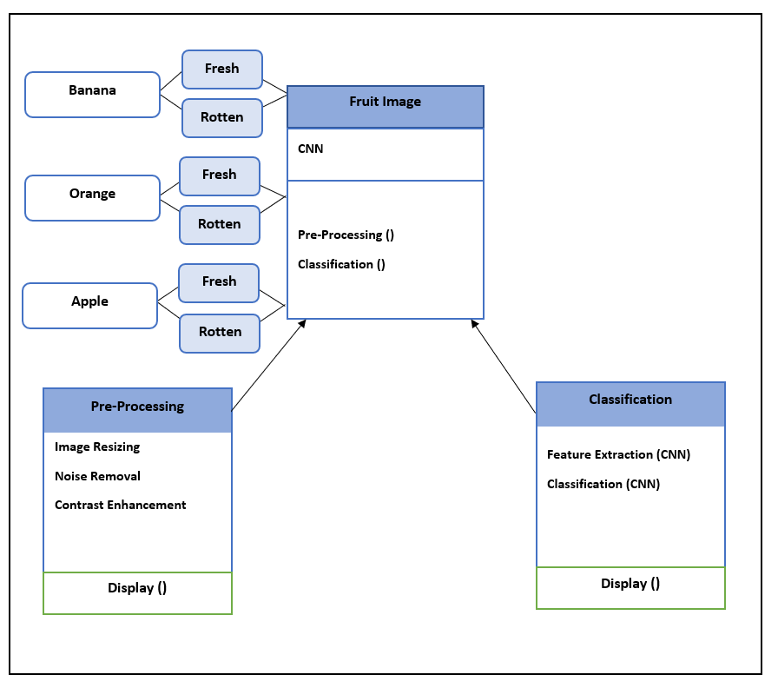
Project Design (Class Diagram)
1/06/2021

Slide 20

User Interface (Splash Screen)
1/06/2021

Slide 21
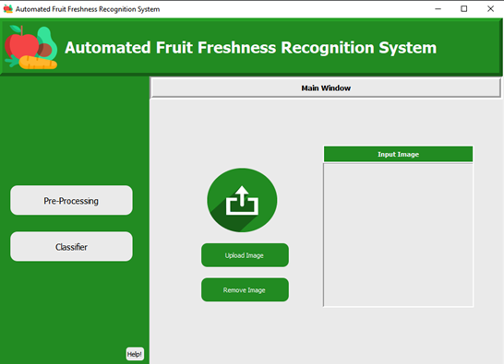
User Interface (Main Window)
1/06/2021

Slide 22
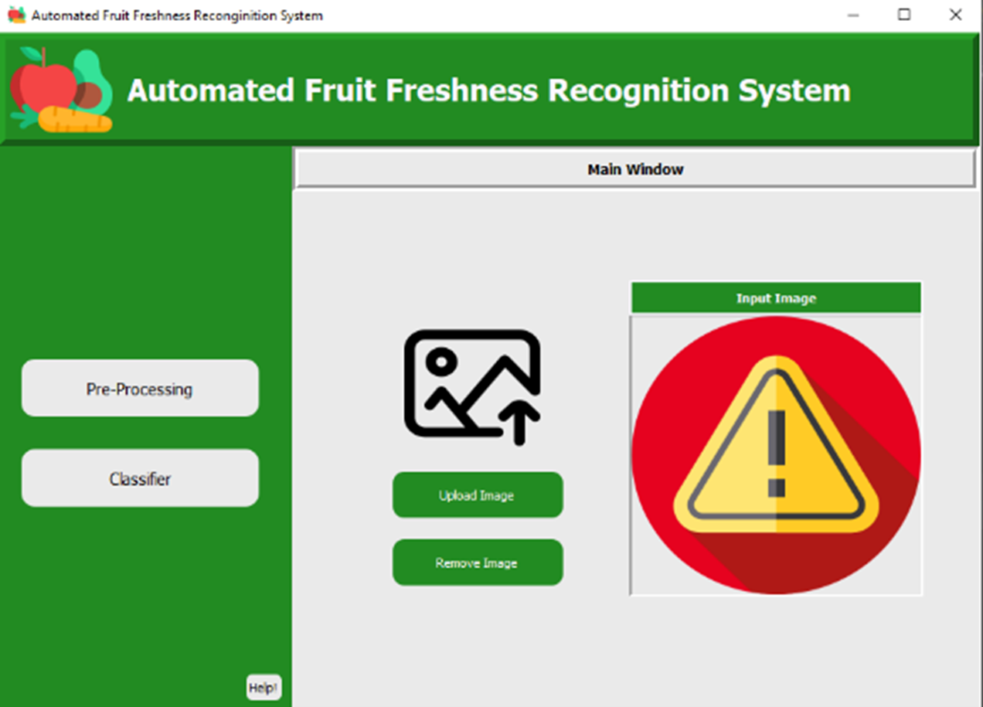
User Interface (No Image)
1/06/2021

Slide 23
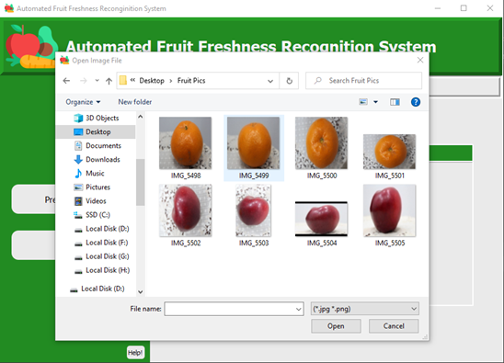
User Interface (Image Uploading)
1/06/2021

Slide 24
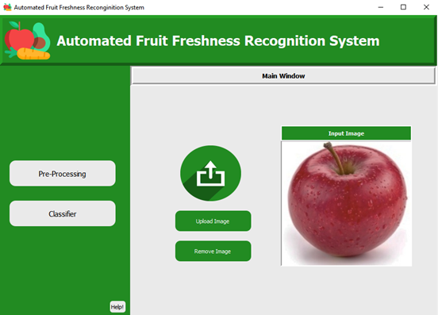
User Interface (Image Upload in Interface)
1/06/2021

Slide 25
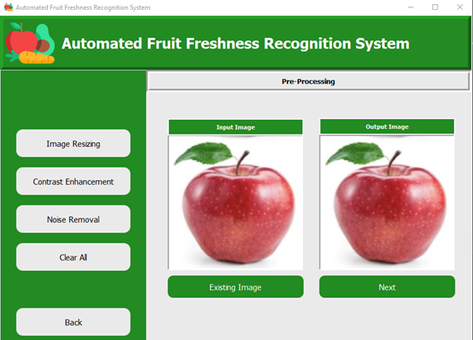
User Interface (Pre-processing)
1/06/2021

Slide 26
Pre-processing (Image Resizing)
1/06/2021

Slide 27

Pre-processing (Contrast Enhancement)
1/06/2021

Slide 28

Pre-processing (Noise Removal)
1/06/2021

Slide 29
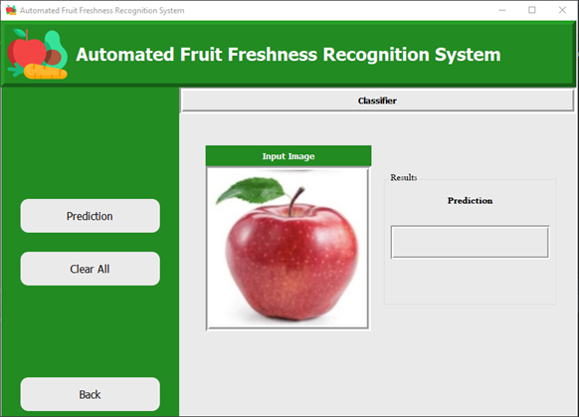
User Interface (Classification)
1/06/2021

Slide 30

Classification (Result)
1/06/2021

Slide 31
Tools
Anaconda distribution.
JetBrains PyCharm.
Window 10
Pyqt Designer.
MS Word for Documentation.
MS PowerPoint for Presentation slides.
Programming Language
Python
1/06/2021

Slide 32
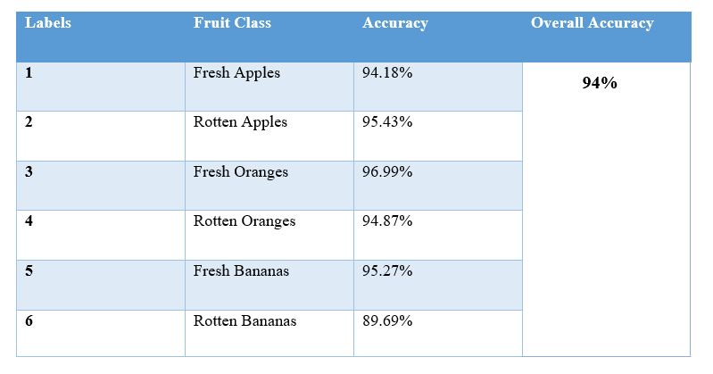
Results
1/06/2021

Slide 33
Conclusion
After the study and implementation of deep learning in the field of fruit freshness it is concluded that using Convolutional Neural Network (CNN) provides very competitive results.
The model of CNN is trained for the test of the 6 different fruit classes.
Convolution Neural Network generate the promising results.
CNN returns 94% accuracy of the network.
1/06/2021

Slide 34
Future Work
In near future, this Fruit freshness system would help the large markets to check the fruit freshness avoiding the traditional method of examination.
In future we will aim to extend the proposed model by including additional types of fruits other than apple, orange, and banana.
Our System is based on machine learning techniques, hence in future a camera can be used to classify the fruit freshness real time.
1/06/2021

Slide 35
References
Sa, I., Ge, Z., Dayoub, F., Upcroft, B., Perez, T., & McCool, C. (2016). DeepFruits: A Fruit Detection System Using Deep Neural Networks. Sensors, 16(8), 1222. https://doi.org/10.3390/s16081222
Bargoti, S., & Underwood, JSong, Y., Glasbey, C. A., Horgan, G. W., Polder, G., Dieleman, J. A., & van der Heijden, G. W. A. M. (2014). Automatic fruit recognition and counting from multiple images. Biosystems Engineering, 118, 203–215. https://doi.org/10.1016/j.biosystemseng.2013.12.008
. (2017). Deep fruit detection in orchards. 2017 IEEE International Conference on Robotics and Automation (ICRA). https://doi.org/10.1109/icra.2017.7989417
h Fu, Y., 2020. Fruit Freshness Grading Using Deep Learning. [ebook] School of Engineering, Computer and Mathematical Sciences. Available at: <https://openrepository.aut.ac.nz/bitstream/handle/10292/13353/Fruit_Fu_24May2020_wyan.pdf> [Accessed 7 October 2020].
Kalluri, S. R. (2018, August 24). Fruits fresh and rotten for classification. Retrieved October 7, 2020, from https://www.kaggle.com/sriramr/fruits-fresh-and-rotten-for-classification
1/06/2021

Slide 36

1/06/2021

Slide 37
Thank You

